Slide 1
SIT32004 ICT Application Development
Lecture 03
Software Life Cycle

Slide 2
The lecture notes are from Marty Stepp’s lecture notes. For the further information, visit the following URL.
https://faculty.washington.edu/stepp/courses/2005spring/tcss360/
Lecture note 00 Software Cycle
Lecture note 04 UML Class Diagrams
Lecture note 07 UML Sequence Diagrams

Slide 3
Software engineering
Software engineering: the profession, practiced by developers, concerned with creating and maintaining software applications by applying technologies and practices from computer science, project management, and other fields.
Software engineering has accepted as its charter, "How to program if you cannot." -- E. Dijkstra
The first step toward the management of disease was replacement of demon theories and humours theories by the germ theory. That very step, the beginning of hope, in itself dashed all hopes of magical solutions. It told workers that progress would be made stepwise, at great effort, and that a persistent, unremitting care would have to be paid to a discipline of cleanliness. So it is with software engineering today. -- F. Brooks

Slide 4
Roles of people in software
people involved in software production
customer / client: wants software built
often doesn't know what he/she wants
managers / designers: plan software
difficult to foresee all problems and issues in advance
developers: write code to implement software
it is hard to write complex code for large systems
testers: perform quality assurance (QA)
it is impossible to test every combination of actions
users: purchase and use software product
users can be fickle and can misunderstand the product

Slide 5
Ad-hoc software development
ad-hoc development: creating software without any formal guidelines or process
what are some disadvantages of ad-hoc development?
some important actions (testing, design) may go ignored
not clear when to start or stop doing each task
does not scale well to multiple people
not easy to review or evaluate one's work

Slide 6
Ad-hoc software development
ad-hoc development: creating software without any formal guidelines or process
what are some disadvantages of ad-hoc development?
some important actions (testing, design) may go ignored
not clear when to start or stop doing each task
does not scale well to multiple people
not easy to review or evaluate one's work

Slide 7
Lifecycle phases
standard phases
Requirements Analysis & Specification
Design
Implementation, Integration
Testing, Profiling, Quality Assurance
Operation and Maintenance
other possible phases
risk assessment: examining what actions are critical and performing them first (part of Spiral model)
prototyping: making a quick version of the product and using it to guide design decisions

Slide 8
One view of SW cycle phases
Requirements
Elicitation
Analysis
System
Design
Object
Design
Implemen-
tation
Testing
Implemented
By
Expressed in Terms Of
Structured By
Realized By
Verified
By
class...
class...
class...
?
class....
?
Use Case
Model
Application
Domain
Objects
Solution Domain
Objects
Subsystems
Source
Code
Test
Cases

Slide 9
Some software models
Several models for developing software (besides ad-hoc) have been attempted:
code-and-fix: write some code, debug it, repeat until finished
evolutionary: build initial requirement spec, write it, then "evolve" the spec and code as needed
waterfall: perform the standard phases (requirements, design, code, test) in sequence
rapid prototyping: write an initial "throwaway" version of the product, then design, code, test
spiral: assess risks at each step, and do the most critical action immediately

Slide 10
code-and-fix model
Code First
Version
Modify until
Client is satisfied
Operations Mode
Retirement

Slide 11
Problems with code-and-fix
What are some reasons not to use the code-and-fix model?
code becomes expensive to fix (bugs are not found until late in the process)
code didn't match user's needs (no requirements phase!)
code was not planned for modification, not flexible

Slide 12

Waterfall model (Royce, 1970)
Req. Change
Requirements
Verify
Design
Verify
Implementation
Test
Operations
Retirement

Slide 13
Rapid prototyping model
Req. Change
Rapid Prototype
Verify
Redesign
Verify
Re-implementation
Test
Operations
Retirement

Slide 14
Waterfall / Prototyping issues
The waterfall models (with or without prototyping) are perhaps the most common model for software development
we will use waterfall in this course!
What are some positives and negatives about this method?
+ formal, standard, has specific phases with clear goals
+ good feedback loops between adjacent phases
- rigid, too linear; not very adaptable to change in the product
- requires a lot of planning up front (not always easy / possible)
- assumes that requirements will be clear and well-understood

Slide 15
Spiral model (Boehm)

Slide 16
Another view of spiral model
Risk Assessment
Req. Change
Requirements
Risk Assessment
Verify
Design
Risk Assessment
Verify
Implementation
Test
Adds a Risk Analysis
step to each phase
(phases may not be completed in this order
any more!)
Operations
Retirement

Slide 17
Spiral model problems
What are some positives and negatives about this method?
+ focuses attention on reuse
+ accommodates changes, growth
+ eliminates errors and unattractive choices early
+ limits to how much is enough (not too much design, reqs, etc)
+ treats development, maintenance same way
- matching to contract software (doesn't work well when you're bound to a fixed inflexible contract)
- relying on developers to have risk-assessment expertise
- need for further elaboration of project steps (clearer milestones)

Slide 18
Unified Modeling Language
Class Diagram

Slide 19
Design phase
design: specifying the structure of how a software system will be written and function, without actually writing the complete implementation
a transition from "what" the system must do, to "how" the system will do it
What classes will we need to implement a system that meets our requirements?
What fields and methods will each class have?
How will the classes interact with each other?

Slide 20
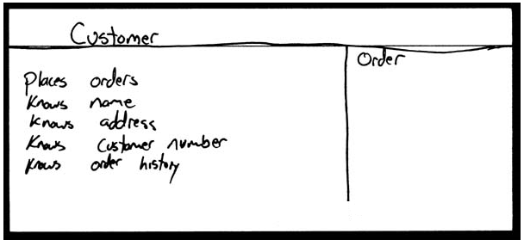
How do we design classes?
class identification from project spec / requirements
nouns are potential classes, objects, fields
verbs are potential methods or responsibilities of a class
CRC card exercises
write down classes' names on index cards
next to each class, list the following:
responsibilities: problems to be solved; short verb phrases
collaborators: other classes that are sent messages by this class (asymmetric)
UML diagrams
class diagrams (today)
...
Notes:
Class-responsibility-collaboration card

Slide 21
Introduction to UML
UML: pictures of an OO system
programming languages are not abstract enough for OO design
UML is an open standard; lots of companies use it
What is legal UML?
a descriptive language: rigid formal syntax (like programming language)
a prescriptive language: shaped by usage and convention (like UML)
it's okay to omit things from UML diagrams if they aren't needed by team/supervisor/instructor

Slide 22
Uses for UML
as a sketch: to communicate aspects of system
forward design: doing UML before coding
backward design: doing UML after coding as documentation
often done on whiteboard or paper
used to get rough selective ideas
as a blueprint: a complete design to be implemented
sometimes done with CASE (Computer-Aided Software Engineering) tools
as a programming language: with the right tools, code can be auto-generated and executed from UML
only good if this is faster than coding in a "real" language

Slide 23
UML class diagrams
What is a UML class diagram?
What are some things that are not represented in a UML class diagram?
UML class diagram: a picture of the classes in an OO system, their fields and methods, and connections between the classes that interact or inherit from each other
details of how the classes interact with each other
algorithmic details; how a particular behavior is implemented

Slide 24
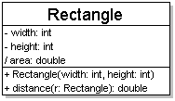
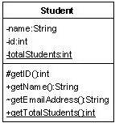
Diagram of one class
class name in top of box
write <<interface>> on top of interfaces' names
use italics for an abstract class name
attributes (optional)
should include all fields of the object
operations / methods (optional)
may omit trivial (get/set) methods
but don't omit any methods from an interface!
should not include inherited methods

Slide 25
Class attributes
attributes (fields, instance variables)
visibility name : type [count] = default_value
visibility: + public # protected - private ~ package (default) / derived
underline static attributes
derived attribute: not stored, but can be computed from other attribute values
attribute example: - balance : double = 0.00

Slide 26
Class operations / methods
operations / methods
visibility name (parameters) : return_type
visibility: + public # protected - private ~ package (default)
underline static methods
parameter types listed as (name: type)
omit return_type on constructors and when return type is void
method example: + distance(p1: Point, p2: Point): double

Slide 27
Relationships between classes
generalization (an inheritance relationship)
inheritance between classes
interface implementation
association (a usage relationship)
dependency
aggregation
composition

Slide 28
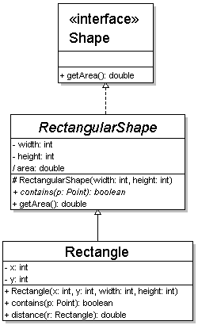
Generalization relationships
generalization (inheritance) relationships
hierarchies drawn top-down with arrows pointing upward to parent
line/arrow styles differ, based on whether parent is a(n):
class: solid line, black arrow
abstract class: solid line, white arrow
interface: dashed line, white arrow
we often don't draw trivial / obvious generalization relationships, such as drawing the Object class as a parent

Slide 29
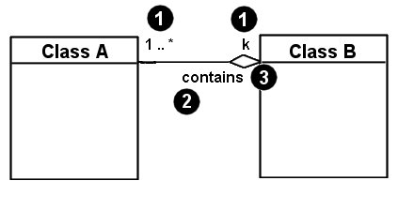
Associational relationships
associational (usage) relationships
1. multiplicity (how many are used)
* ⇒ 0, 1, or more
1 ⇒ 1 exactly
2..4 ⇒ between 2 and 4, inclusive
5..* ⇒ 5 or more
2. name (what relationship the objects have)
3. navigability (direction)

Slide 30
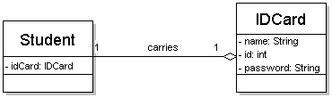
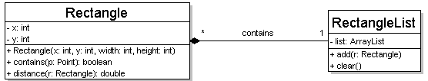
Multiplicity of associations
one-to-one
each student must carry exactly one ID card
one-to-many
one rectangle list can contain many rectangles

Slide 31
Association types
Car
1
1
aggregation
aggregation: "is part of"
symbolized by a clear white diamond
composition: "is entirely made of"
stronger version of aggregation
the parts live and die with the whole
symbolized by a black diamond
dependency: "uses temporarily"
symbolized by dotted line
often is an implementation detail, not an intrinsic part of that object's state
Engine
Book
composition
1
*
Page
dependency
Lottery Ticket
Random

Slide 32
Class diagram example
StudentBody
Student
1
100
- firstName : String
- lastName : String
- homeAddress : Address
- schoolAddress : Address
+ main (args : String[])
+ toString() : String
Address
- streetAddress : String
- city : String
- state : String
- zipCode : long
+ toString() : String

Slide 33
Unified Modeling Language
Sequence Diagram

Slide 34
UML sequence diagrams
sequence diagram: an "interaction diagram" that models a single scenario executing in the system
perhaps 2nd most used UML diagram (behind class diagram)
relation of UML diagrams to other exercises:
CRC cards -> class diagram
use cases -> sequence diagrams

Slide 35
Key parts of a sequence diag.
participant: an object or entity that acts in the sequence diagram
sequence diagram starts with an unattached "found message" arrow
message: communication between participant objects
the axes in a sequence diagram:
horizontal: which object/participant is acting
vertical: time (down -> forward in time)

Slide 36
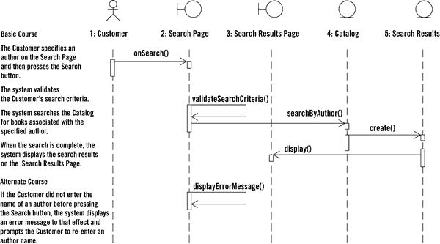
Sequence diag. from use case

Slide 37
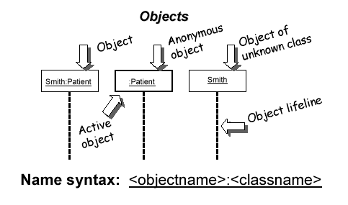
Representing objects
squares with object type, optionally preceded by object name and colon
write object's name if it clarifies the diagram
object's "life line" represented by dashed vert. line

Slide 38
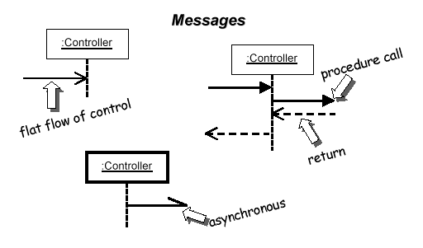
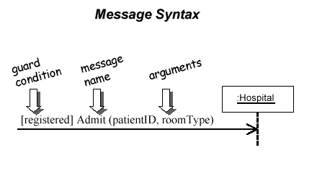
Messages between objects
message (method call) indicated by horizontal arrow to other object
write message name and arguments above arrow
dashed arrow back indicates return
different arrowheads for normal / concurrent (asynchronous) methods

Slide 39
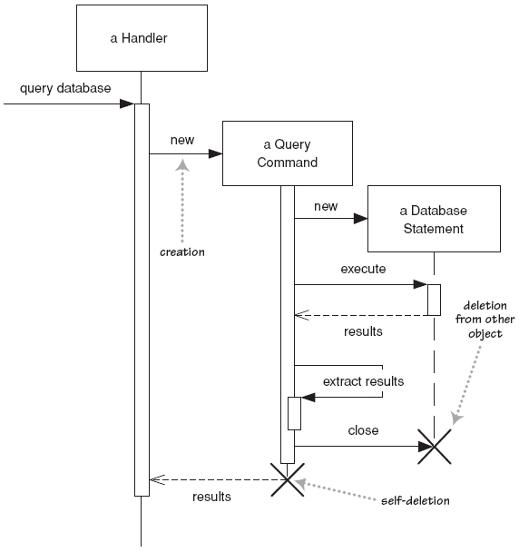
Lifetime of objects
creation: arrow with 'new' written above it
notice that an object created after the start of the scenario appears lower than the others
deletion: an X at bottom of object's lifeline
Python doesn't explicitly delete objects; they fall out of scope and are garbage-collected

Slide 40
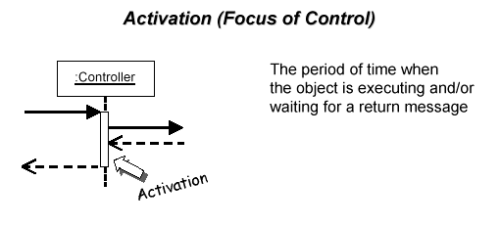
Indicating method calls
activation: thick box over object's life line; drawn when object's method is on the stack
either that object is running its code, or it is on the stack waiting for another object's method to finish
nest to indicate recursion
Activation
Nesting

Slide 41
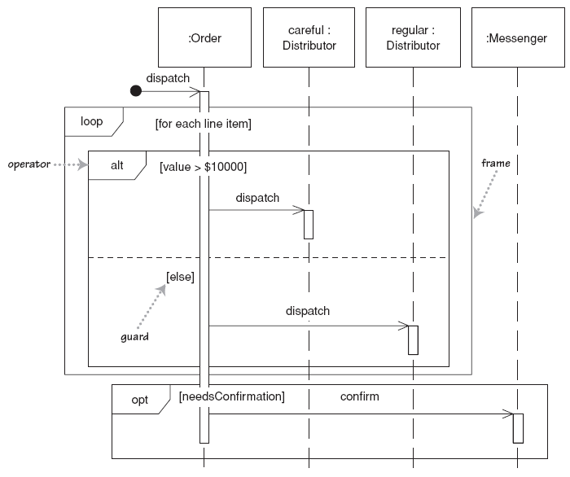
Indicating selection and loops
frame: box around part of a sequence diagram to indicate selection or loop
if -> (opt) [condition]
if/else -> (alt) [condition], separated by horiz. dashed line
loop -> (loop) [condition or items to loop over]
opt
[
balance
alt
<>
0
]
[
balance
<
100
.
00
]
[
balance
>
=
100
.
00
]
loop
[
balance
<
0
]

Slide 42
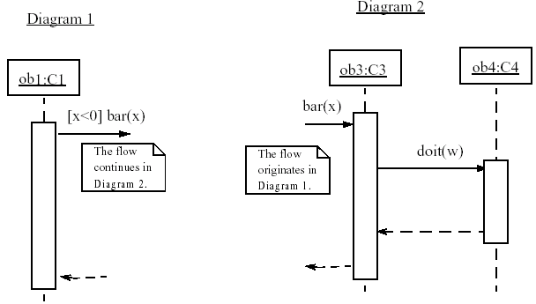
linking sequence diagrams
if one sequence diagram is too large or refers to another diagram, indicate it with either:
an unfinished arrow and comment
a "ref" frame that names the other diagram
when would this occur in our system?

Slide 43
Example sequence diagram

